Slide 1
2015-18 English Premier League IST687 – Introduction to Data Science Group 2
Amani Alawneh, Martin Alonso, Michael Cerutti, Susannah Cleland

Slide 2
The Data
This project works with data from the English Premier League.
The data gathered includes:
Goals scored (including at half-time), goals allowed, shots taken and allowed, win, lose, or drew, fouls committed, and whether they received any yellow or red cards.
We expect teams that score more goals tend to win more games but, looking at goal differential, we might find that this is not the case.
We also want to see whether there are other factors that are pushing a teams’ likelihood to win - such as:
The number of shots, shots on goal, and corner kicks taken.
Home field advantage.
Categorical data such as the referee overseeing the match.
We manipulated the dataset to try and gauge the following:
Factors are able to predict a win.
Factors likely to separate winning teams from losing teams.
What can teams from the bottom of the chart learn from teams at the top.

Slide 3

Business Questions
Is there a home-field advantage in soccer?
Does the score at half-time affect the final score of the game?
Are the number of fouls, cards, shots allowed, and the result of the game correlated?
This Photo by Unknown Author is licensed under CC BY-SA

Slide 4
Data Manipulation
Our first quality assessment was to check that there were no missing values within the dataset.
After that, we made sure that the data types were correct, i.e. strings weren’t stored as factors, numbers were numeric, and dates were stored as dates.
Last, we transformed the dataset in order to have one row per team per date, renamed the columns, dropped the betting line columns, and added a flag to signal whether the team in question was the home or away team.
The original dataset had 65 columns and 380 rows. The variables included date, teams playing, referee, match results and goals both at half-time and at the end of regulation, match statistics.
We transformed this data so as to end with 24 columns and 780 rows.
In addition, we also created three columns:
A Win Flag.
Half-time Goal Differential.
Sum of yellow and red cards.

Slide 5
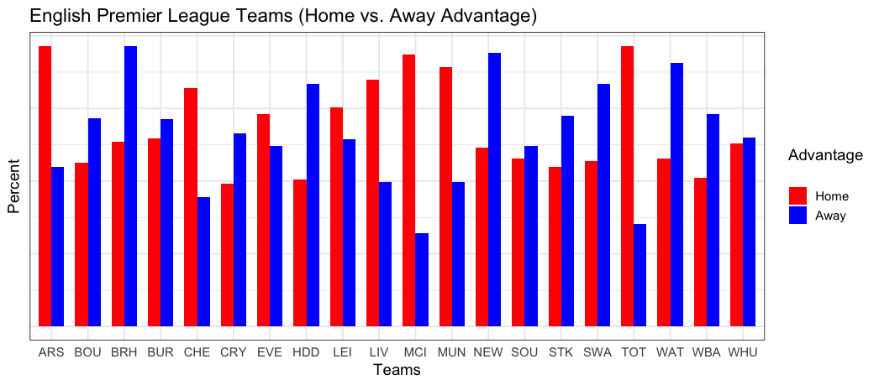
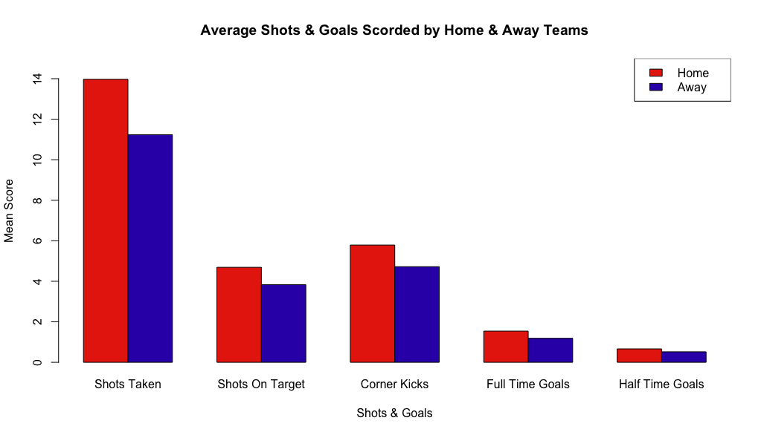
Descriptive statistics
We found that home-field advantage was significant when determining a win.
This is probably due to the natural competitiveness of the EPL.
Only two teams have a Home/Avay split that is significant, while one has a bigger away split.
Home teams tend to have more shot opportunities but they don’t appear to be significant.

Slide 6
Answers
When using Logistic Variable reduction we the more meaningful factors that influenced the result of a game were:
Example Scenarios from the model:
Team has: 2 goals | 0 Halftime Diff | 3 shots on target for opponent | 1 Red Card
TEAM HAS AN 55% CHANCE OF WINNING
Team has: 2 goals | -1 Halftime Diff | 4 shots on target for opponent | 0 Red Card
TEAM HAS AN 37% CHANCE OF WINNING
Variable | Coefficient explained | P VALUE
Goals Scored | 1.96 - more goals the better | <.05 (<2e-16)
Halftime Differential | .969- winning at halftime the better | <.05 (<2e-16)
Opp. Shots on Target | -0.52- less shots on target given up | <.05 (<2e-16)
Red Cards | -0.75 – less red cards results in more wins | .0188

Slide 7
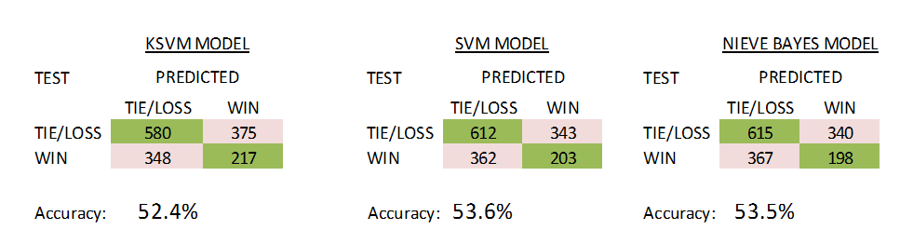
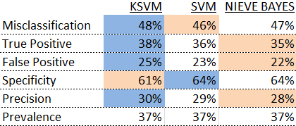
Answers
Using the same variables we built additional models to compare for accuracy
We compared three models (KSVM, SVM, and Naïve Bayes) and found the SVM model to be the most accurate, correctly predicting 53.6% of results
We need to re-assess and pull in other variables or models for consideration.
We also measured other rates for the models.

Slide 8
Conclusions
We found that Home Field Advantage had very little effect on the outcome of a match (51 percent).
Score at half-time also has a high correlation when explaining the end result.
Team discipline (shots allowed, fouls committed, cards received) did have an effect on the outcome of the match.
There are many more factors we would have wanted to explore (i.e betting odds, free kicks, player history) that could better predict match outcome.

